Slide 1
Clinical Decision Making and Pattern Recognition in Healthcare
Chain Reasoning, Agentic Generative AI, Classification, Prediction, Inference, Clustering, & Time-Series Anomaly Detection for TPO
Cami Call
August 25th, 2024

Slide 2
Report Overview
Introduction
Relevant Trends
Opportunities for Cotiviti
Threats & Challenges
Strategic Recommendations
Conclusion

Slide 3
Introduction
Clinical Decision Making and Pattern Recognition:
Central to healthcare, impacting diagnosis, treatment, and management.
Integration of AI and ML has transformed these processes.
Cotiviti’s Opportunity:
Leverage advanced analytics to enhance clinical outcomes and operational efficiency.

Slide 4
Relevant Trends
AI and ML in Healthcare:
Chain Reasoning: Links related medical events to inform decisions.
Agentic Generative AI: Simulates human decision-making for personalized treatments.
Classification & Prediction: Critical for diagnosing diseases and predicting outcomes.
Inference & Clustering: Identifies patterns and patient subgroups for targeted care.
Time-Series Anomaly Detection: Monitors patient vitals and detects health issues early.

Slide 5
Opportunities for Cotiviti
Enhanced Analytics Solutions: Offer sophisticated tools for improved patient care and cost management.
Identification of High-Risk Patients: Use classification and clustering to tailor interventions and prevent complications.

Slide 6
Threats and Challenges
Investment & Integration:
High costs and need for specialized talent in AI and ML.
Data Privacy Concerns:
Ensuring compliance with regulations and maintaining trust.
Technology Complexity:
Challenges in integrating AI into legacy systems.

Slide 7
Strategic Recommendations
1. Invest in AI & ML Capabilities: Focus on chain reasoning, generative AI, and anomaly detection.
2. Develop Strategic Partnerships: Collaborate with AI technology providers and academic institutions.
3. Prioritize Data Privacy & Security: Implement robust governance frameworks.
4. Offer Tailored Solutions: Develop specialized analytics for chronic disease management and value-based care.

Slide 8
Conclusion
Cotiviti’s Path Forward:
Embrace AI and ML to enhance healthcare analytics.
Strategic actions will strengthen Cotiviti's market position and improve patient outcomes.

Slide 9
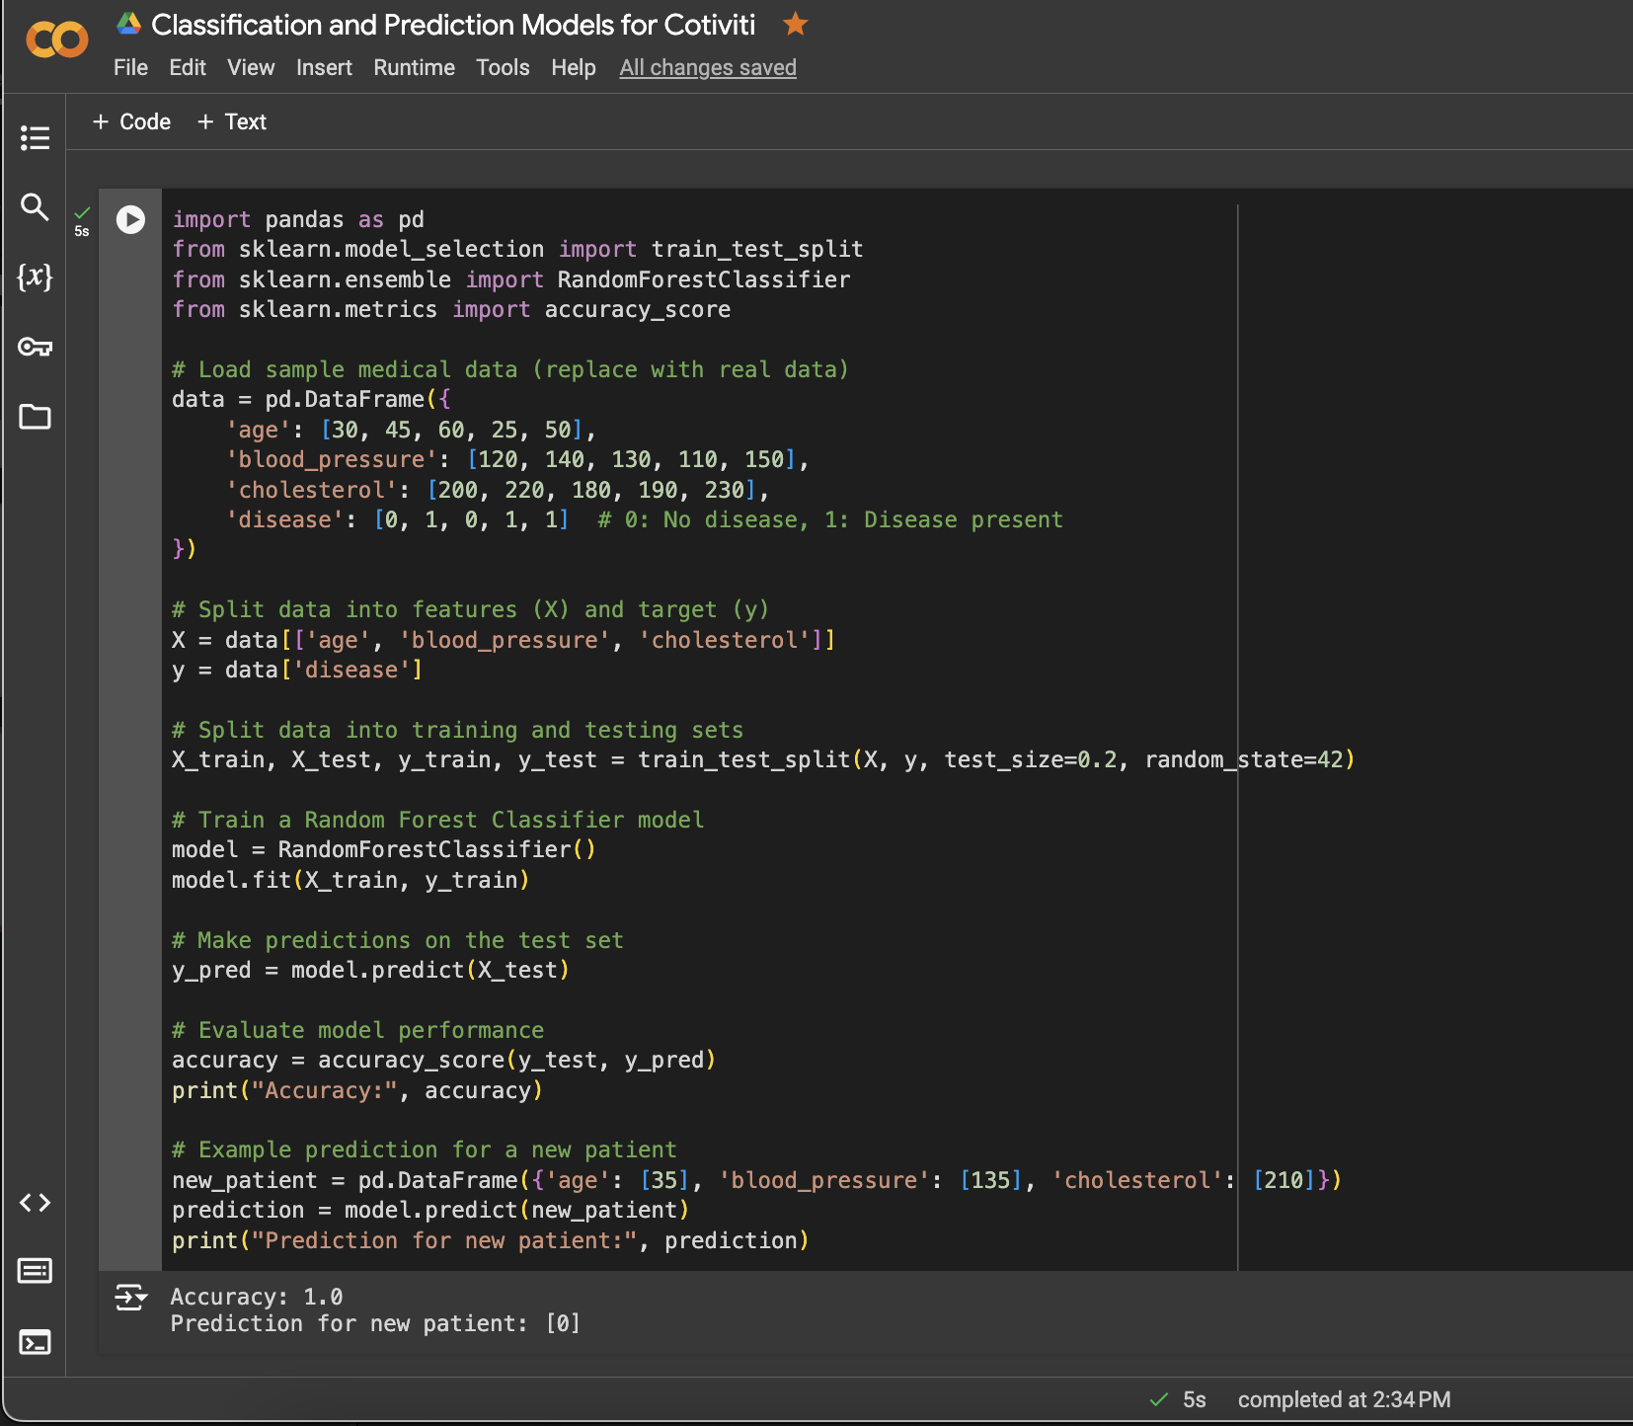
Overview of Proof of Concept
This proof of concept (PoC) I’ve developed demonstrates the practical application of ML techniques (Random Forest Classifier) to predict whether or not a patient has a disease based on their data. This demonstration is designed to showcase how HCPs can take advantage of the power behind predictive analytics to make more accurate and informed clinical decisions.
Data Preparation
This PoC starts off with loading a sample dataset, using pandas, that contains medical data from a small group of patients. The dataset includes three main features:
Age
Blood Pressure
Cholesterol Levels
These features serve as the input variables used to predict the target variable, which is what we are trying to “find out” i.e. whether or not the patient has a disease (1) or not (0).
2. Data Splitting
The dataset is then split into 2 training sets: training and testing. This is accomplished through the sklearn ’train_test_split’ method. This process separates the data into:
Features (X): The independent variables (‘age’, ‘blood_pressure’, ‘cholesterol’).
Target (y): The dependent variable, what we are predicting (‘disease’).
The data is then further divided into:
Training Set: 80% of the data is used to “train” the Random Forest model.
Testing Set: 20% of the data is used to evaluate the model’s performance.
Link to Colab Notebook:
https://colab.research.google.com/drive/1y39ldgJMnDbAdzQPDEBxZLyTui5kXGfy?usp=sharing

Slide 10
PoC Continued
3. Model Training
A Random Forest Classifier, a robust learning method, is trained based on the Training Set of data. The model learns to identify patterns in the features that are correlated with either the presence of the absence of the disease.
4. Model Evaluation
Once the model has been trained, its performance is than evaluated against the Testing Set of data. The ‘accuracy_score’ metric is used to analyze how well the model predicts the presence of disease in data it has never seen before. The accuracy score provides a quantitative evaluation of the model’s predictive ability.
5. Making Predictions
The PoC displays a practical example in which the trained model is used to predict the likelihood of disease in a new patient based on factors like their age, blood pressure, and cholesterol levels. The prediction result is then outputted as either 0 (signaling no disease) or 1 (signaling disease).
Overall Significance of this PoC
Through this proof of concept, I have clearly demonstrated just the tip of the iceberg when it comes to the potential of machine learning in clinical decision-making. Through being able to more accurately predict the presence of diseases based on basic and readily accessible medical data, healthcare providers can:
Identify at-risk patients more efficiently.
Tailor interventions and treatment plans to individual patients.
Improve patient outcomes through the use of predictive analytics.
This PoC could be expanded with larger and more diverse datasets to further refine the model through more training to increase its accuracy and ensure its applicability in real-world clinical settings.

Slide 11
Thank You!
Email any questions to camryn.call@colorado.edu.

